Slide 1
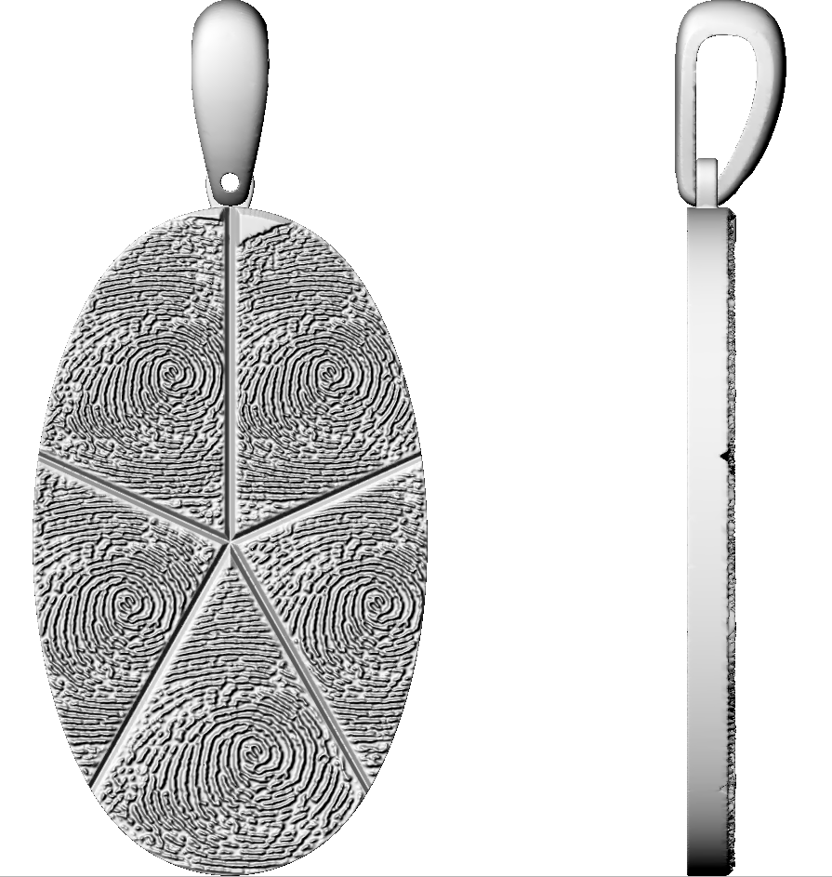
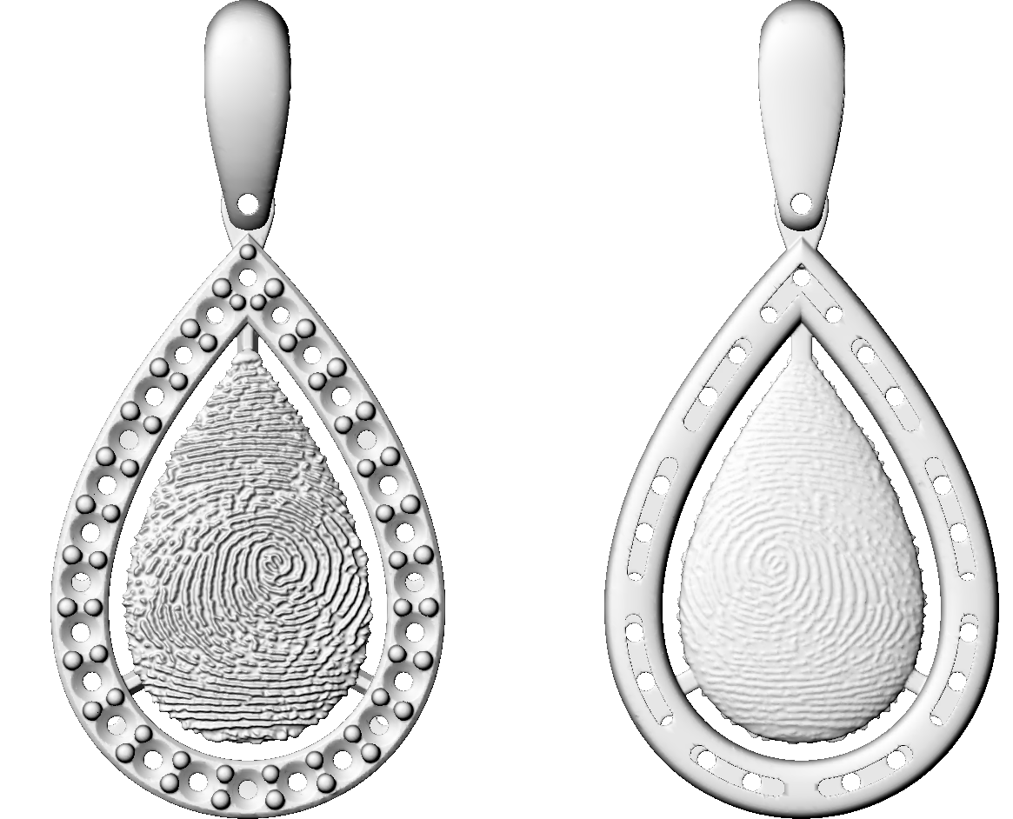
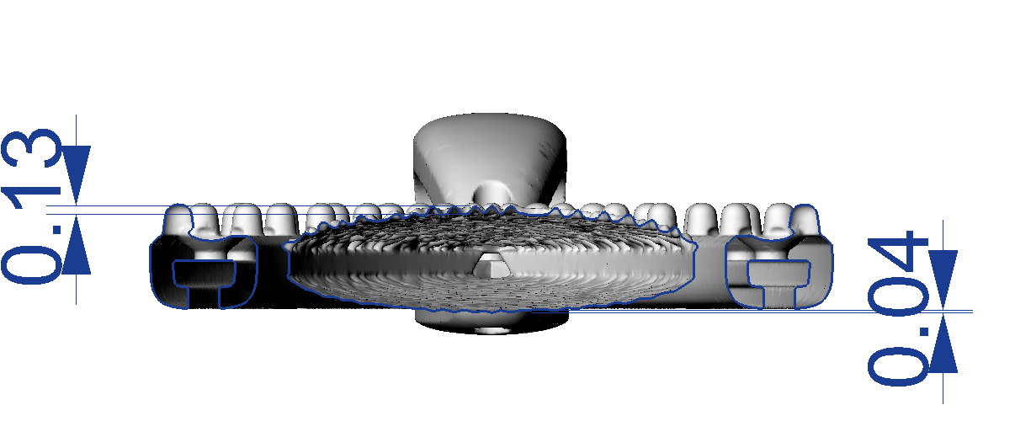
PDG040
P246442LY
Top view
Bottom- view
FP_ZONE_4
FP_ZONE_3
FP_ZONE_1_FACE
FP_ZONE_2_FACE
FP_ZONE_5
FP_ZONE_2
0.13mm
0.04mm
FP_ZONE_1
0.25mm
DNJ comments:- Depth of finger-print in all zone is 0.25mm.
Slight metal visible in zone_3 near loop area.
DNJ comments:- Depth of zone_1 is 0.13mm.
Depth of zone_2 is 0.04mm.

